Slide 1
Carbonyl compounds
II B.Sc
Semester-III
Paper-III
P. R. Government College (Autonomous) , Kakinada
Guthula Sandhya

Slide 2












Carbonyl compounds having the general strutures
General formula is C_{n}H_{2n}O
In Ketones, when two groups are same are known as Simple ketones and
when two groups are not same known as Mixed ketones eg.

Slide 3
















Nomenclature

Slide 4
Synthesis of Aldehydes and Ketones
From Acid Chlorides
From 1,3-Dithianes
From Nitriles (Cyanides)
From Carboxylic acids

Slide 5





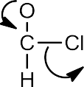

A. From Acid Chlorides
1. Rosenmund reduction:

Slide 6




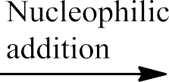
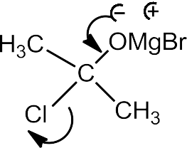
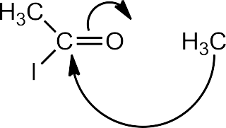



Slide 7


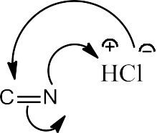



B. From 1,3-Dithianes
C. From Nitriles (Cyanides)

Slide 8
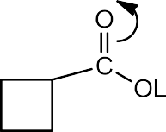
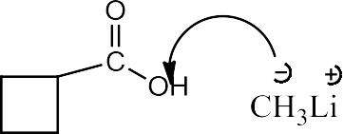



Carboxylic acids

Slide 9
General Physical Properties
Aldehydes (C₂ to C₁₁) and ketones (C₃ to C₁₁) are colourless, mobile liquids
Aldehydes and Ketones > C₁₁ are solids
Aldehydes (Unpleasant smell), Higher ones have fruity smell
ketones (Pleasant smell)
Solubility rapidly falls with rising M. wt. due to increase hydrophobic chain

Slide 10


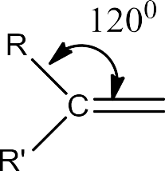

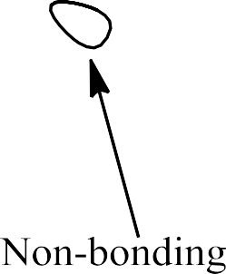









Structure of carbonyl groups

Slide 11
Reduction Reactions
Nucleophilic Additions
Condensation Reactions
Hydride Transfer Reaction
Condensation Reactions with ammonia derivatives
Reaction with Phosphine derivatives
Oxidation Reactions
Polymerisation

Slide 12












1

Slide 13









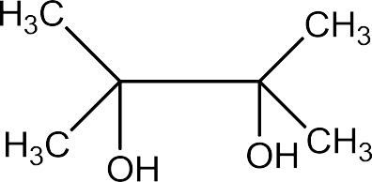




Slide 14



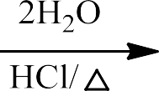


2

Slide 15
















Slide 16










3

Slide 17

















Slide 18






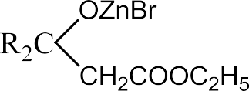

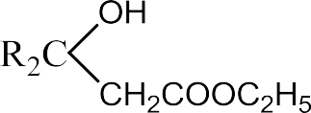




Slide 19








4

Slide 20
THANK you

